Slide 1
Helen VS Jeniffer
Helen Vilela

Slide 2
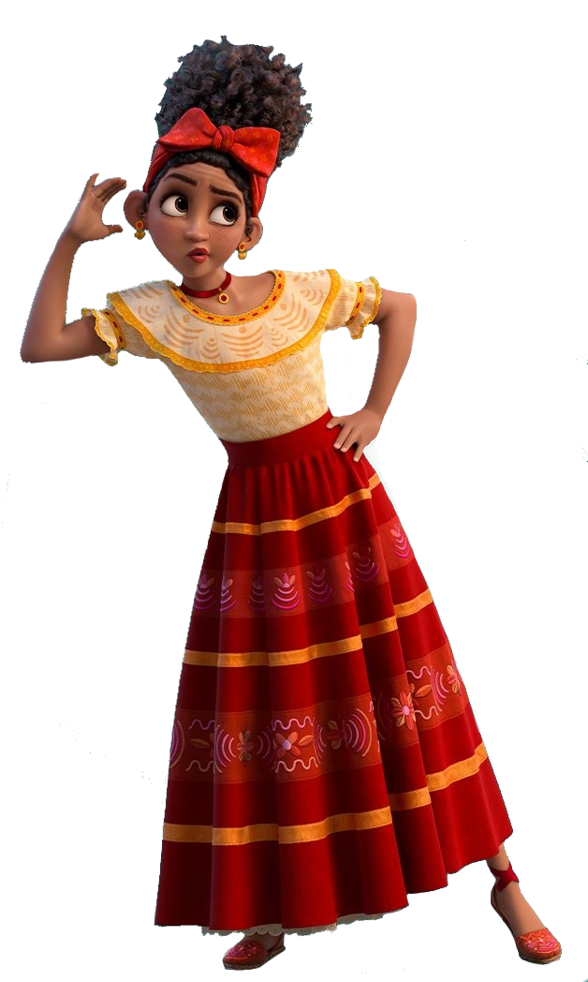
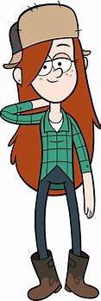
Com quem se parece?
MEU
DELA

Slide 3
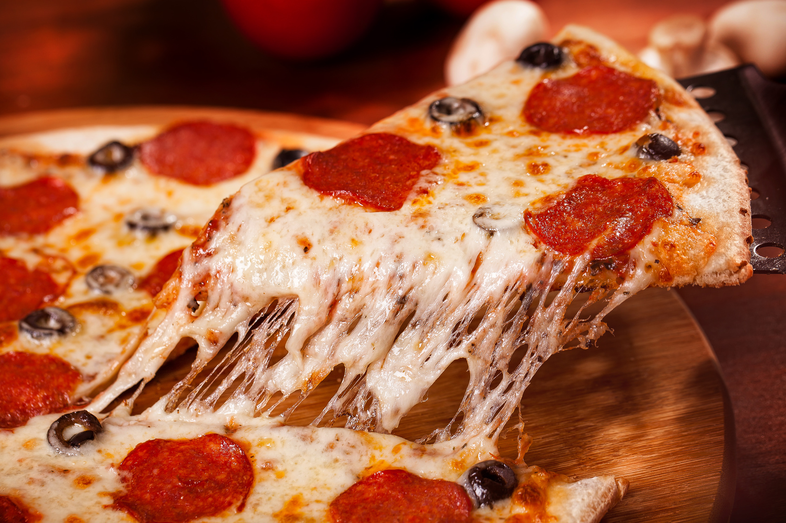
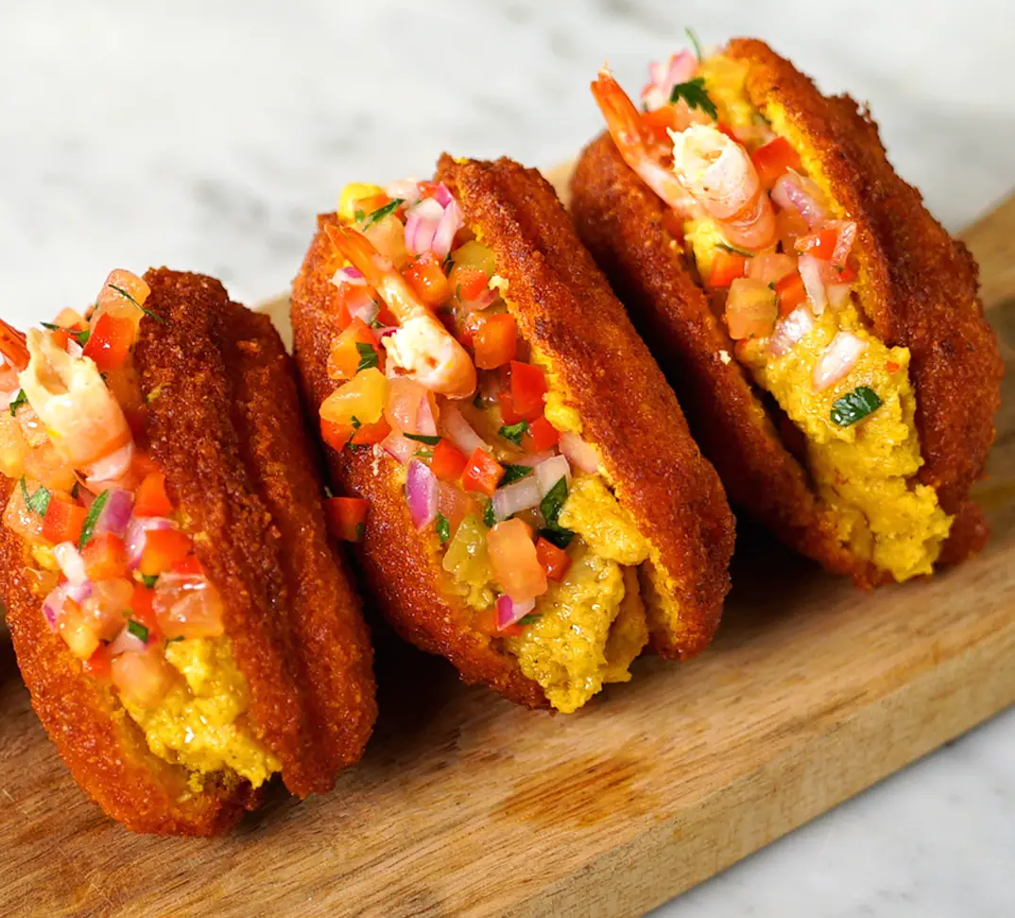
Comida favorita
MEU
DELA

Slide 4


Música Favorita
HELEN
https://www.bing.com/ck/a?!&&p=22d4db7254f037adJmltdHM9MTcxMjYyMDgwMCZpZ3VpZD0zMTNjZjJjMy03MWQzLTYxM2UtMmRhZS1lMTVkNzBiODYwZWYmaW5zaWQ9NTI4Mw&ptn=3&ver=2&hsh=3&fclid=313cf2c3-71d3-613e-2dae-e15d70b860ef&psq=25+e+natal+31+e+ano+novo+letra&u=a1aHR0cHM6Ly93d3
JENIFFER
https://www.bing.com/ck/a?!&&p=22d4db7254f037adJmltdHM9MTcxMjYyMDgwMCZpZ3VpZD0zMTNjZjJjMy03MWQzLTYxM2UtMmRhZS1lMTVkNzBiODYwZWYmaW5zaWQ9NTI4Mw&ptn=3&ver=2&hsh=3&fclid=313cf2c3-71d3-613e-2dae-e15d70b860ef&psq=25+e+natal+31+e+ano+novo+letra&u=a1aHR0cHM6Ly93d3

Slide 5
CARACTERÍSTICAS
HELEN
JENIFFER
Branca
Atenciosa
Inteligente
Tímida
Cantora
Atenciosa com quem eu amo
Parda
Grossa
Chata
Fumante
Insuportavel
Deselegante
Brega
Mal-educada
Incoveniente
Hipócrita

Slide 6

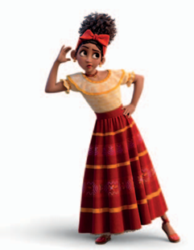
ELOGIOS
JENIFFER
Bonita
Legal
Gente boa
Inteligente
Fofoqueira
Engraçada
Sincera

